Slide 1

Enabling Reproducibility with Docker

Slide 2
Enabling Reproducibility with Docker
Daniel Trahan
Email: Daniel.Trahan@Colorado.edu
RC Homepage: https://www.colorado.edu/rc
RC Email: rc-help@colorado.edu
Slides available for download at: https://github.com/ResearchComputing/Containers_Fall_2021

Slide 3
Outline
Part 1: Container fundamentals and Docker (9/22/21)
Reproducibility and the Case for Containers
Containers
Docker
Images and Containers
Commands
File Access
Building Docker Images
Dockerhub
Part 2: Containers for HPC w/ Singularity (9/29/21)

Slide 4
Demo Files:
Before we begin I will note that this tutorial will have interactive components.
If you would like to participate in the demos provided for this tutorial then go ahead and clone the test files from the Github.
Navigate to a desired directory
Clone the repository
git clone https://github.com/ResearchComputing/Containers_Fall_2021
Navagate into the directory and store the path into a variable.
cd Containers_Fall_2021
export CONTAINER_ROOT=$(pwd)

Slide 5
Reproducibility and Research
Scientific Software is often challenging to work with
Difficult installation
Low support from the developers
Very outdated
Complex Dependency trees
Because of this its often desired for a software to be repeatable and accurate.
But installs are only done once. Why should I care about reproducible applications.

Slide 6
Reproducibility and Research
Research is Collaborative
Team members work together to get projects done.
Reproducibility ensures all members of a team can provide productivity towards a project.
Research is Correcting
Research is hard
Academic reviews are commonplace
Someone may wish to accurately reproduce your work
Research is Continuous
You may be working on a single project for a long period of time
What happens in you move, but bring your work to another system?

Slide 7
Options for reproducibility
Lots of options!
Detailed instructions
Software bundles
Virtual Environments
Python, Anaconda, Spack
But do they really enable accurate reproducibility?
Incorrect installs?
Hardware or OS?
Performance?

Slide 8
Containers
A Container is a packaged bundle of OS, libraries, software and files that runs as a process under a host OS
Containers use an application on the host operating system called a Container Manager
Manages operating system and libraries run as containers
Like virtual machines, but does not need dedicated CPUs memory or storage

Slide 9
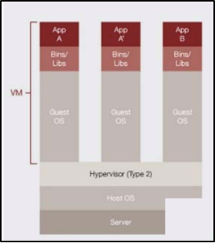
Virtualization (1)
Virtualization is a technology that utilizes software to abstract components of a technology
The most common application is in Hardware Virtualization
Virtual Machines
Partitions off Memory, CPU, GPU, and Storage
Runs a virtual OS
Runs software on the virtualized machine
Examples: VMware, Virtualbox
Material courtesy: M. Cuma, U. Utah

Slide 10
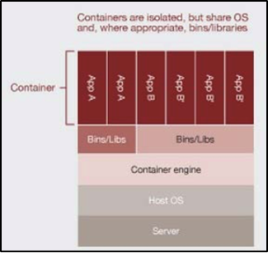
Virtualization (2)
Another use of virtualization is in OS Level Virtualization
Can run many isolated guest OS instances under a host OS
This virtualization is what is used by Docker and other container software.
Best of both worlds!
Isolated environments
No hardware partitioning
Material courtesy: M. Cuma, U. Utah

Slide 11




Containerization Software
Docker
Well established – largest user base
Has Docker Hub for container sharing
Problematic with HPC (Fix incoming!)
Singularity
Designed for HPC
Second largest userbase
Developed for scientific use
Charliecloud; Shifter
Designed for HPC
Based on Docker
Less user-friendly

Slide 12
Installing Docker
Docker Community Edition
Comfy GUI to help keep track of containers and images!
Available on all operating systems
Windows users can enable WSL2 support following the instructions here: https://docs.docker.com/docker-for-windows/install/
Docker toolbox
Legacy solution for Windows and Mac for versions that do not meet the version requirements.
Utilizes the Virtual Box hypervisor for virtualization

Slide 13
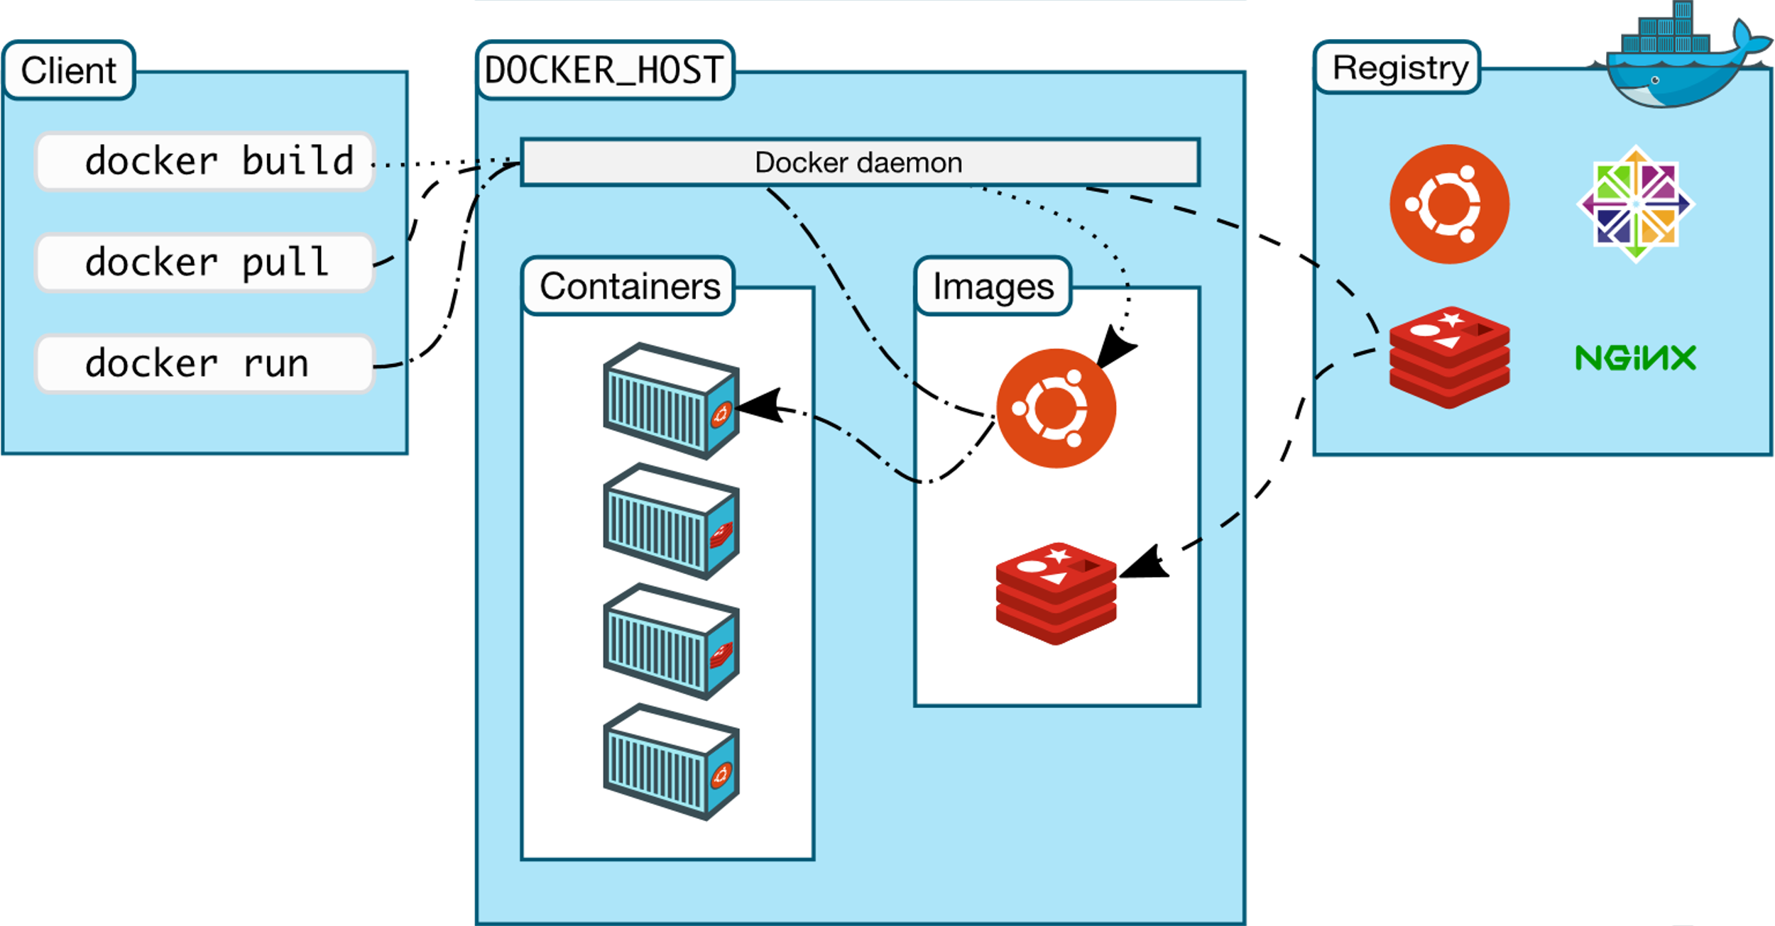
Docker Nuts and Bolts
Docker runs on a concept of images and containers.
Images: Saved snapshots of a container environment.
Made from a Dockerfile or pulled from Docker Hub
Stored in the Docker cache on your disk
Immutable (mostly…)
Containers: Instances of images that are generated by Docker when an image is 'run'
Instance of image running in memory
Ephemeral and state cannot be saved
Can be run interactively

Slide 14
Docker ‘Hello World’
Let's start with something simple:
Docker "Hello, World!"
Relatively small image
No dependencies
Built as a general test case
Command we will run:
docker run hello-world

Slide 15
Docker Commands
Docker Commands are usually in the form of:
docker <sub-command> <flags> <target/command>
Examples:
docker run -it myimage
docker container ls
docker image prune

Slide 16
Launching a Docker Container
Launch docker image as a container:
docker run <image-name>
Run a docker image interactively:
docker run -it <image-name>
If an image is not on the system, then Docker will search Dockerhub to see if the image exists.
Specify commands after your image to execute specific software in your container.
docker run <image-name> <program>

Slide 17
Exploring a Docker Container
Docker containers are running tiny operating systems!
We can explore the operating system by invoking a shell
docker run -it ubuntu bash
This command launches the ubuntu Docker container with the command ‘bash’

Slide 18
Demo 1: Running a Container

Slide 19
Demo 1: GROMACS
GROMACS is a molecular dynamics application that can often be a complex and challenging installation for the average user. Linux and Mac only
Dense Documentation
Software requires compilation
Luckily, this can be trivialized with Docker!
Run the command:
docker run gromacs/gromacs gmx help commands
docker run -it gromacs/gromacs

Slide 20
Docker Image/Container Commands
Container Commands​ | ​
docker container ls ​ | List docker containers currently running:​
docker container rm <container>​ docker rm <container> ​ | Remove (an) container(s):​
docker container prune​ | Remove all stopped containers​
Image Commands​ | ​
docker image ls ​ | List docker images stored in cache:​
docker image rm <image>​ docker rmi <image> ​ | Remove (an) image(s):​
docker image prune​ | Remove unused images​

Slide 21
Docker Image/Container Commands
Commands​ | ​
docker info​ | Shows Docker system-wide information​
docker inspect <docker-object>​ | Shows low-level information about an object​
docker config <sub-command>​ | Manage docker configurations​
docker stats <container>​ | Shows container resource usage​
docker top <container>​ | Shows running processes of a container​
docker version​ | Shows docker version information​
More details and commands can be found on the docker documentation page

Slide 22
Dockerhub
The place where containers live!
Dockerhub is a Docker hosted library of public and private Docker images.
Free and unlimited public images
1 free private repository
Great for hosting images for fellow researchers
Commands like git

Slide 23
Building a Docker Container
To build a docker container, we need a set of instructions Docker can use to set up the environment.
Dockerfile
Once we set up our Dockerfile we can use the command
docker build –t <image-name> .
Then we can run the image with our docker run command
docker run <image-name>

Slide 24
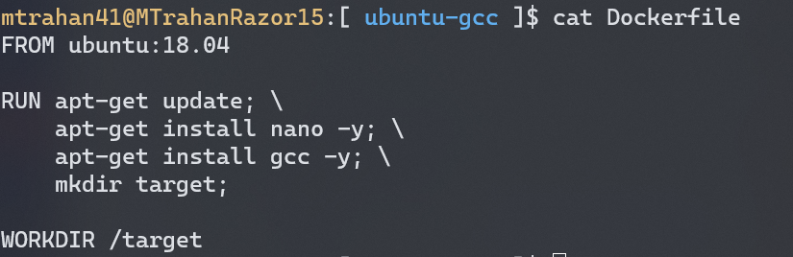
Whats in a Dockerfile
A Dockerfile is simply a text file that contains instructions to build and setup a default Image
Commands to build
Setting commands
Requires a source Image

Slide 25
Demo 2: Building a Docker Image

Slide 26
Demo 2: Ubuntu w/ GCC
For this first example we will be building a custom Ubuntu image that will provide a location to run the GNU Compiler Collection.
Dockerfile provided:
Need to build:
Navigate to the directory:
cd $CONTAINER_ROOT/dockerdemo/ubuntu-gcc
Build the image with:
docker build -t test-gcc .
Run the image as a container:
docker run -it test-gcc

Slide 27
Mounting and File Access (1)
So now that we have a working container, how can we access the test files we downloaded?
Mounting directories: Bind Mount
Allows the docker container to access files on the host OS
Choose host's source directory, files in the directory will be moved to the container's target directory
Source Directory: Directory on the host system. Never within a container.
Target Directory: Directory in the Docker Container. Never on the host system.
A flag set within the docker run command:
docker run -v <source-dir>:<target-dir> <image>

Slide 28
Mounting and File Access (2)
Mounting directories: Volume Mount
Same concept, but volumes are stored within docker cache.
Create Docker volumes in your terminal and link your volume directory
Similarly linked through the docker run command.
docker run -v <volume-name>:<target-dir> <image>

Slide 29
Demo 2 (Cont.): Mounting
Returning to our demo, can we give our container access to our test files?
Let's use a bind mount!
In the directoru where our Dockerfile lives, use this command (all on one line):
docker run -it -v $(pwd)/source:/target happy-gcc
We can cd /target and run our test files!
Command
gcc hello.c -o hello.exe
./hello.exe

Slide 30
Modifying a Docker Image
Suppose you have an existing docker image and want to make changes…
Rebuild Dockerfile!
Usually a bit cumbersome
No Dockerfile?
Use docker commit!
docker run -it <image-name> bash # or any shell...
Then commit it to the image
docker commit <image-id> <image>

Slide 31
Dockerhub Commands
Download and upload docker images with ease.
docker run <image>
docker pull <image>
Uploading a little more complicated...
Sign in with:
docker login
List docker images with:
docker image ls
Tag your image:
docker tag <image-id> <your-username>/<image-name>:<tag>
Push!
docker push <your-username>/<image-name>

Slide 32
Demo 3: NCL container

Slide 33
Demo 3: NCL Container
For this next example we will be building a Docker image that will run the NCAR Command Language (NCL)
Dockerfile provided
Same process:
Navigate to the Dockerfile found at:
$CONTAINER_ROOT/dockerdemo/ncl
Build the Dockerfile and name the image: "ncl-demo"
Run "ncl-demo"
Can we test a sample script?

Slide 34
Docker Compose
External Utility that can create and install docker images.
Builds docker images based on a docker-compose.yml file.
YAML: YAML Ain't Markup Language
Data serialization language
Describes containers you wish to build with what features.
Not a docker command but comes bundled with docker!

Slide 35
Docker Compose Commands
Build all containers in YAML file
docker-compose build
Build and run all containers in YAML file:
docker-compose up
List all containers in YAML file:
docker-compose images
Run a one-off command from a container:
docker-compose run <container-name> <command>

Slide 36
Questions?

Slide 37
Additional Resources
Docker: https://www.docker.com/
Docker Docs: https://docs.docker.com/
Docker Hub: https://hub.docker.com/

Slide 38
Thank you!
Please fill out the survey: http://tinyurl.com/curc-survey18
Contact information: rc-help@Colorado.edu
Slides: https://github.com/ResearchComputing/Containers_Fall_2021

